Slide 1


Personalized Interactions for an Assistive Robot
Master Degree Thesis in ARTIFICIAL INTELLIGENCE AND ROBOTICS
Giorgia Piernoli 1648511
Supervisor: Prof. Luca Iocchi
Academic Year 2019/2020

Slide 2
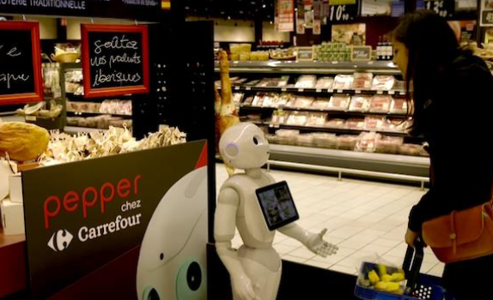
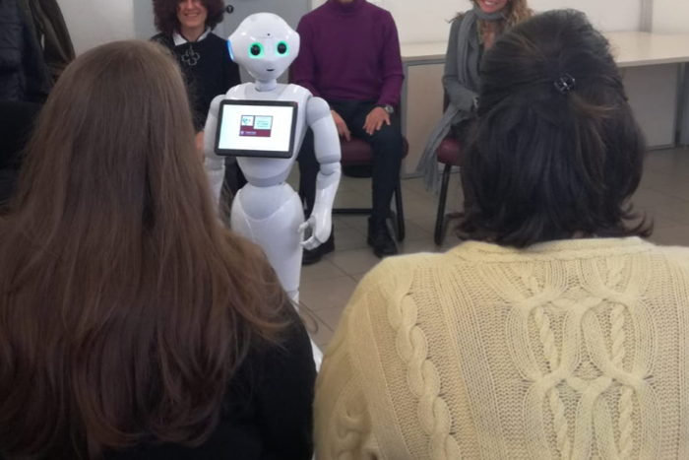
Introduction
HUMAN-ROBOT INTERACTION
capability of enabling robots to successfully interact with humans

Slide 3



TERESA (Therapeutic Educational Robot Enhancing Social InterActions)
Prove that the presence of this social robot could be an help in medical therapies
Series of therapeutic educational meetings with obese patients adding the presence of the social robot as an assistant of the doctor.
Robot can help the interaction with the patients, but it looks ”into space”.
INTERACTION NEEDS TO BE PERSONALIZED

Slide 4
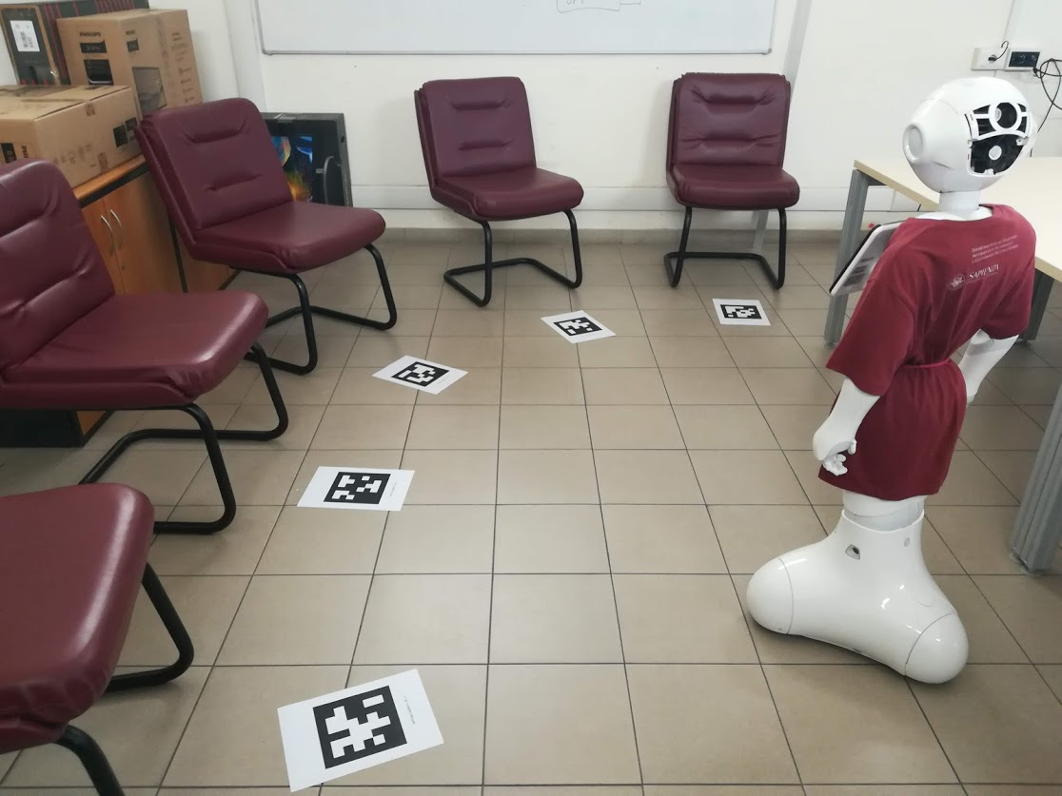
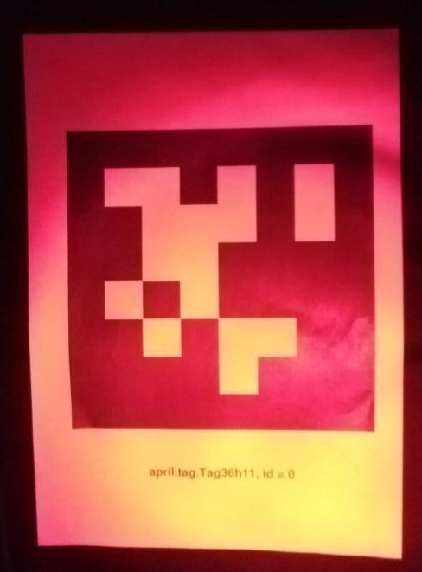
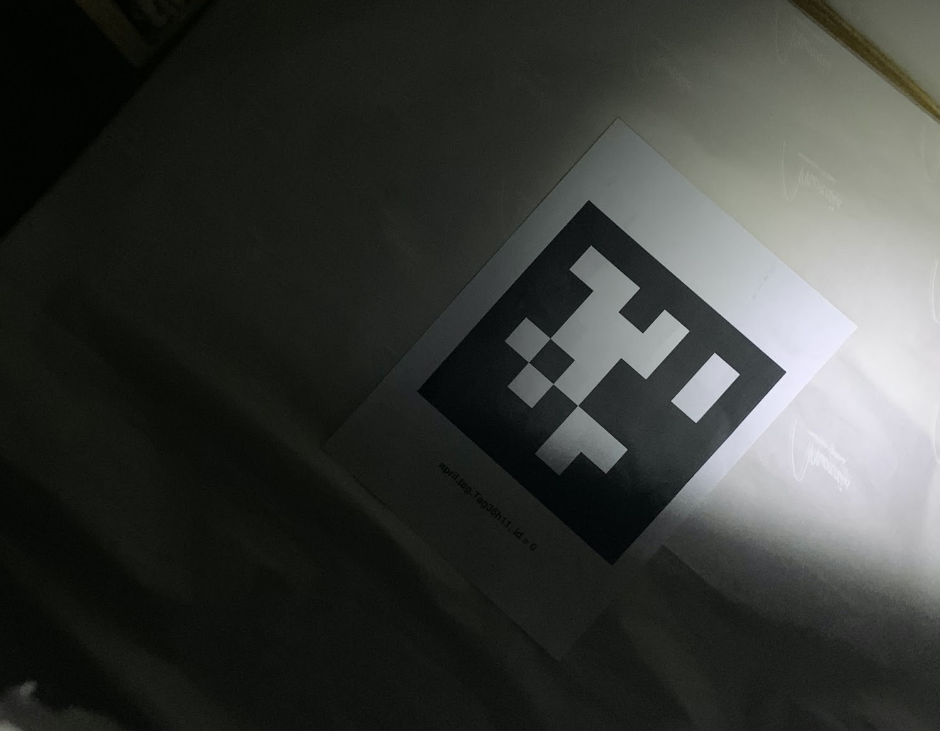
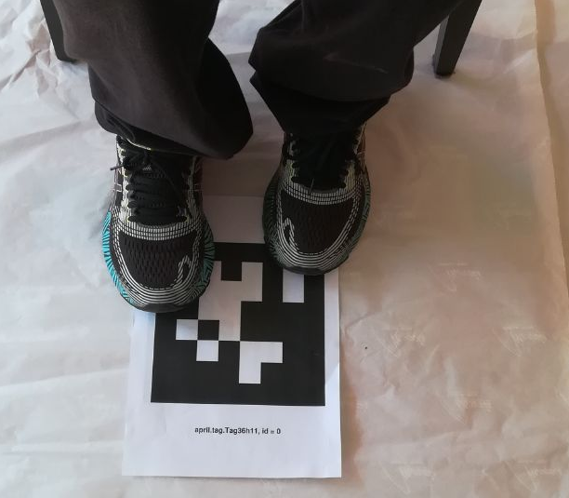
Thesis objective
Personalize the interaction Robot-Patient
Movements of the Robot
through tags
Robustness of the detection system
Hello Laura!

Slide 5
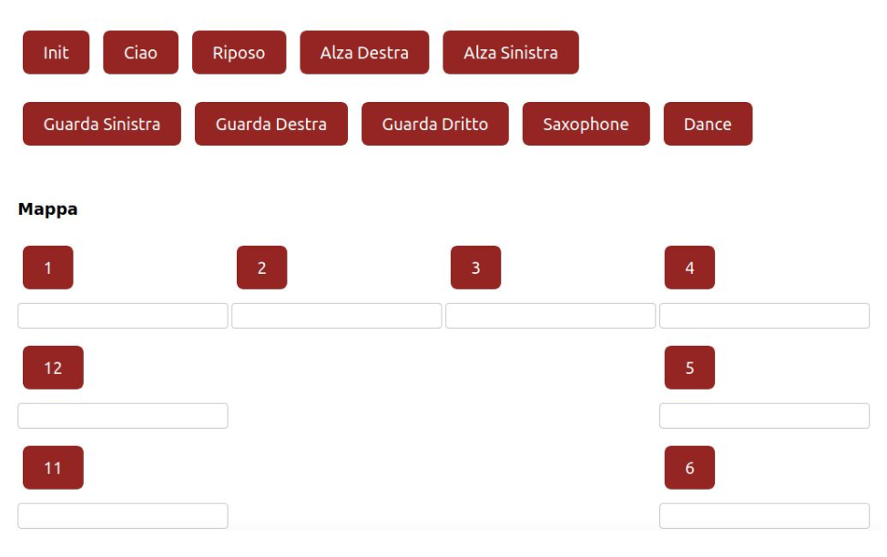
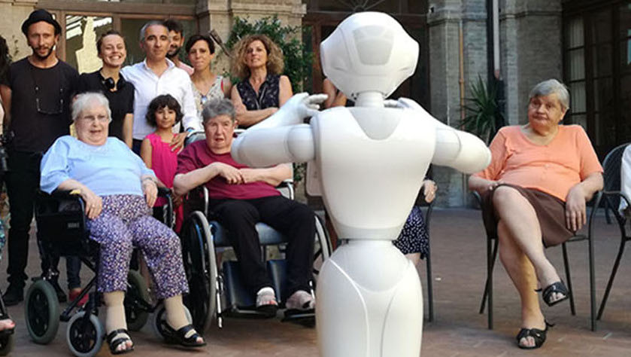
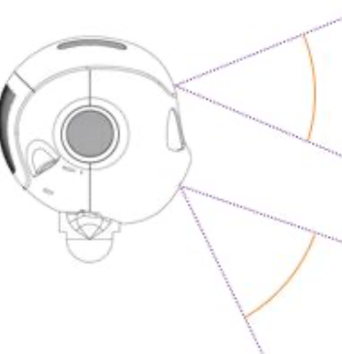
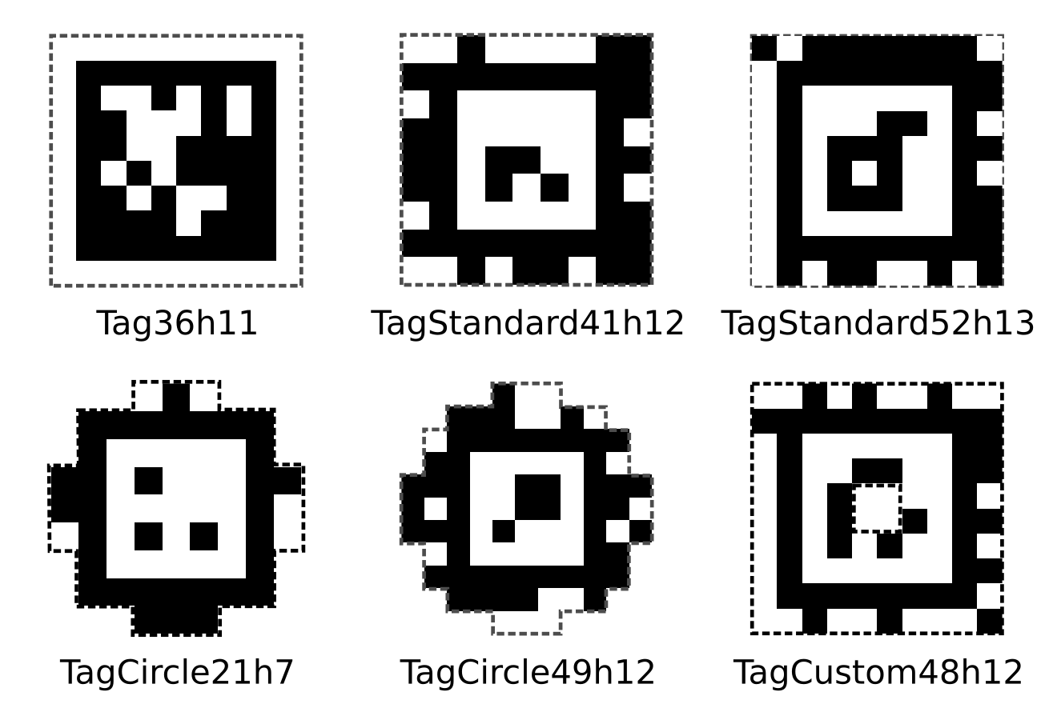
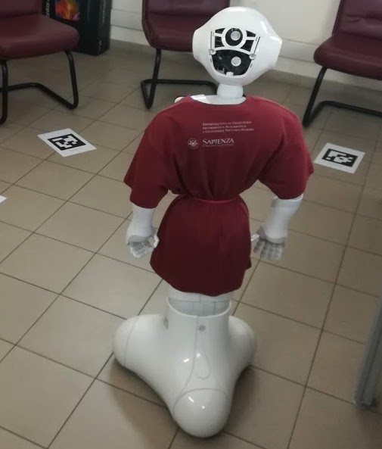
Overview
Web-Interface
“joystick”
Robot-Patient
Evaluation
Movement
Vision

Slide 6
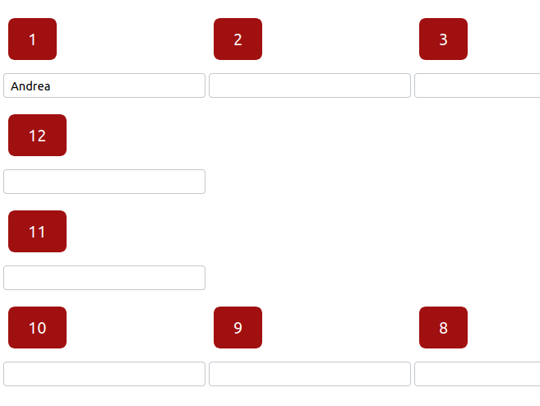
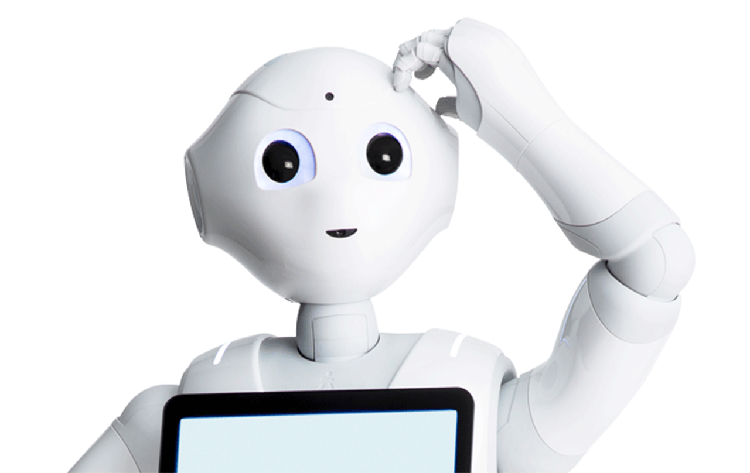
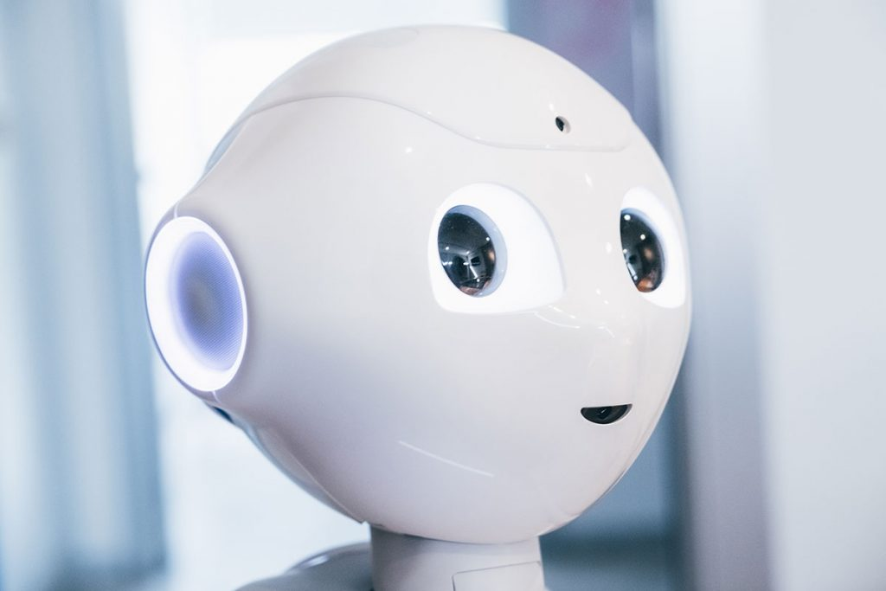

Interaction Personalization
#1 means position 1 that is labelled with Andrea, so..
Andrea, how are you?

Slide 7
AprilTags
Similar to QR Code
High localization accuracy
Tag detector: estimate the position of possible tags in an image.

Slide 8
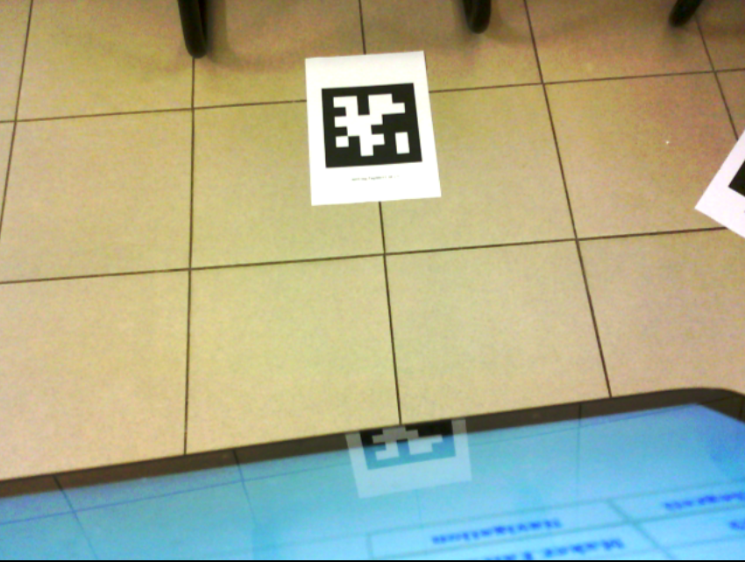
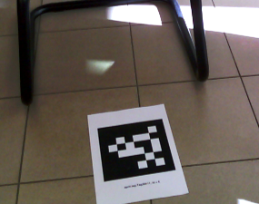
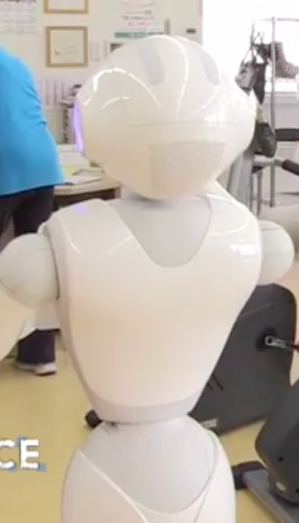
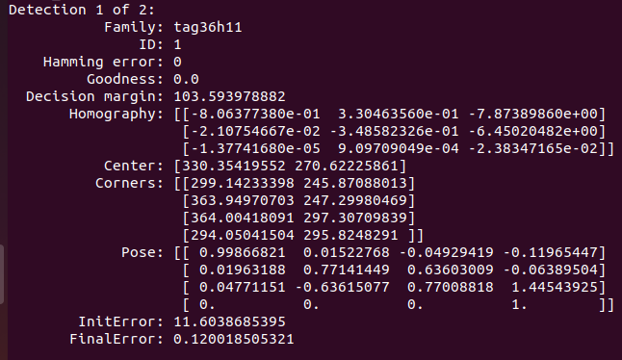
Movement of the Robot: main idea (1)
IF
1) Find the marker
2) Characteristics of the tag
4) Robot movement
3) Euler angles

Slide 9
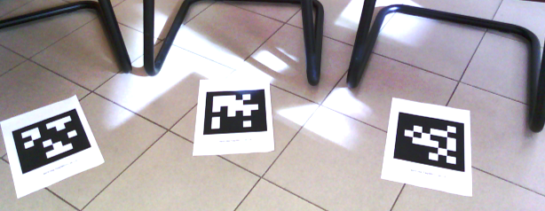
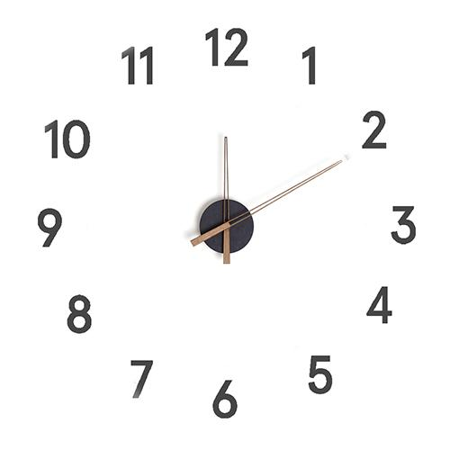
Movement of the Robot: main idea (2)
ELSE
1) ID is not here
2) Rotate in the direction of the desired tag
०
30
3) Find desired ID
IF

Slide 10


Slide 11
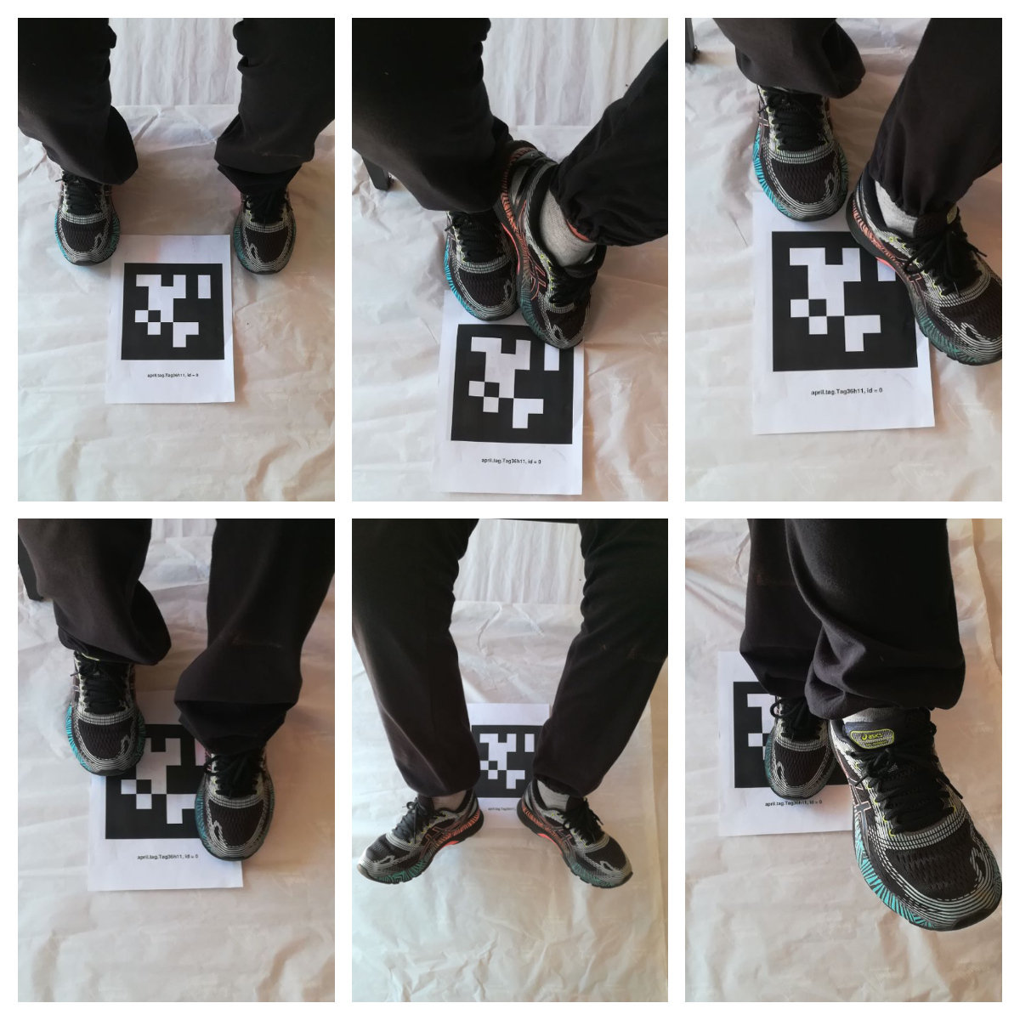

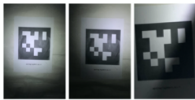
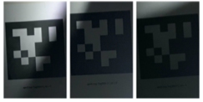
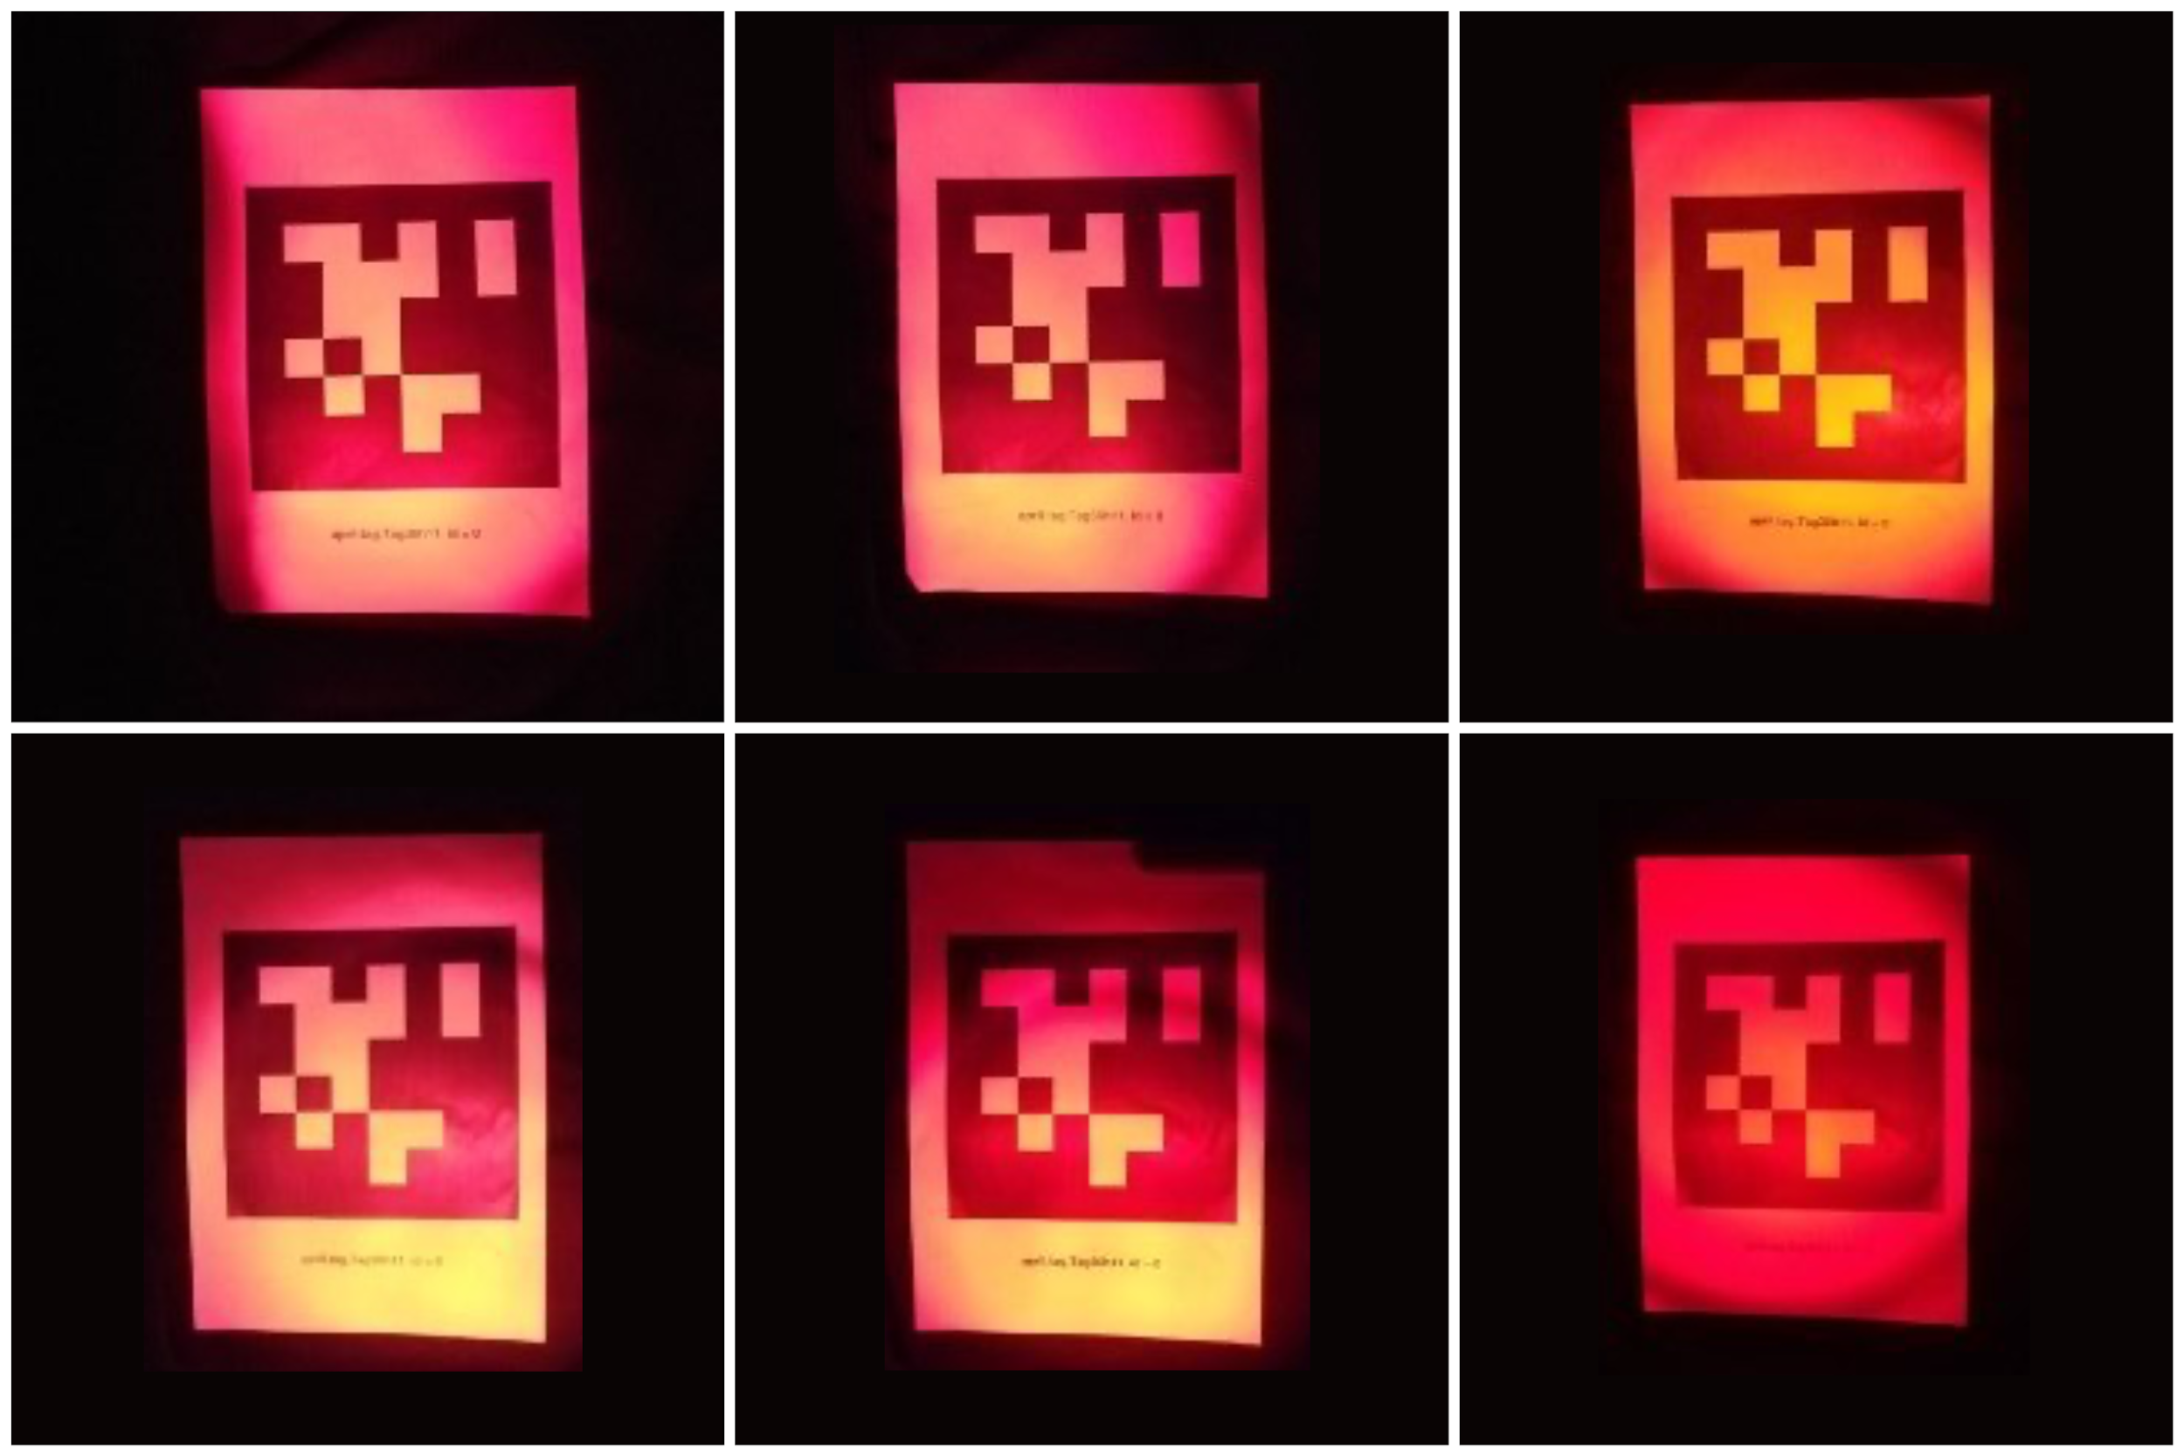
Robustness of detection’s system: experiments

Slide 12
Solution: Human-Robot Interaction
Could you please move your feet?

Slide 13
Conclusions
Performances’ evaluation: HRI and medical
Real meeting with patients and doctors
Compare previous work with ended one

Slide 14
References
[1] Paola Ferrarelli, Mar´ıa T. L´azaro, and Luca Iocchi Design of robot teaching assistants through multi-modal human-robot interactions
[2] Luca Iocchi, Maria Teresa L ́azaro, Laurent Jeanpierre, Abdel-Illah Mouaddib
Personalized short-term multi-modal interaction for social robots assisting users in shopping malls. Dept. of Computer, Control and Management Engineering Sapienza University of Rome, Italy.GREYC, University of Caen Lower-Normandy, France
[3] Pennisi, Andrea; Sahli, Hichem; Jeanpierre,, Laurent; Mouaddib, Abdel-Illah; Iocchi, Luca; Lazaro, Maria Teresa; Erdem, Esra; Demirel, Ezgi; Patoglu, Volkan. COACHES: An assistance Multi-Robot System in public areas
[4] Enrico Prosperi, Giada Guidi, Lucio Gnessi, Luca Iocchi. TERESA: robot sociale per l’assistenza terapeutica. Società Italiana di Educazione Terapeutica, Roma, Italy Dip. di Medicina Sperimentale, Sapienza Università di Roma, Italy. Dip. di Ingegneria Informatica Automatica e Gestionale, Sapienza Università di Roma, Italy
[5] Peter I. Corke. VISUAL CONTROL OF ROBOTS: High-Performance Visual Servoing. CSIRO Division of Manufacturing Technology, Australia.
[6] Edwin Olson. AprilTag: A robust and flexible visual fiducial system. University of Michigan
[7] John Wang and Edwin Olson. AprilTag 2: Efficient and robust fiducial detection.
[8] Luca Iocchi, Dirk Holz, Javier Ruiz-del-Solar, Komei Sugiura, Tijn van der Zant: Analysis and results of evolving competitions for domestic and service robots.
[9] Satya Mallick. Computer Vision Resources
[10] P. F. Felzenszwalb and D. P. Huttenlocher, “Efficient graph-based im- age segmentation,” International Journal of Computer Vision, vol. 59, no. 2, pp. 167–181, 2004.
[11] R. Hartley and A. Zisserman, Multiple View Geometry in Computer Vision, 2nd ed. Cambridge University Press, 2004.
[12] K. Shoemake and T. Duff, “Matrix animation and polar decomposi- tion,” in In Proceedings of the conference on Graphics interface 92. Morgan Kaufmann Publishers Inc, 1992, pp. 258–264.
[13] Robotics Modelling Planning and Control B.Siciliano

